Slide 1
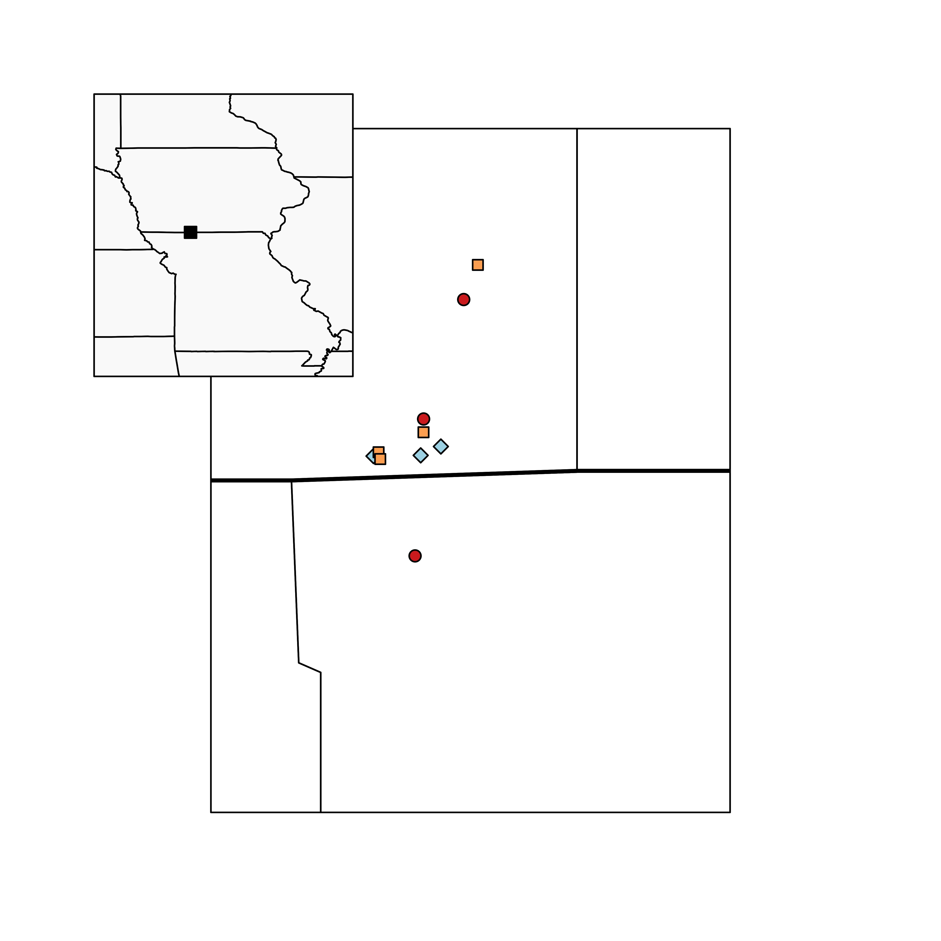
KLN
KLT
RIN
PYN
RIS
Iowa
GIL
PYW
PYS
LTR
Missouri
PAW
= Burn Only
= Graze and Burn
= Patch-Burn Graze

